Slide 1
Financial Time Series Project: In-app Purchase Prediction
Presented by:
Cong Shi
Gunjan Batra
Yahui Guo
Yanchi Liu
Yueqing Zhang

Slide 2
Introduction
Mobile e-commerce is growing rapidly. It gives us more chances to study user behavior and increase customer satisfaction
Given user login, purchase, and mobile device information, we aim to
predict whether a user will make purchase the next day
predict the total amount of purchase for the company hourly
Contents and Speakers:
Feature Extraction (Yanchi)
User prediction
Logistic Regression and SVM (Yueqing)
Random Forest and Boosting (Gunjan)
Company prediction (Cong and Yahui)

Slide 3
Dataset Description
We have three datasets with user historical login and purchase activities collected from a Chinese online store.
1. User IP:
This dataset provides the ip address of user, which can be used as the unique id of user.
117.136.40.197:China:Guangdong:Shenzhen
2. User Login:
This dataset provides the login records of users, which contains user id, login time, and ip address.
4232765,ylt,yltpp_10000version_,3,562fdf64c7ab752e82d0ab9ab7da61b0f3bed000,117.136.40.197,2015-11-01 00:00:04
3. User Purchase:
This dataset provides the purchase records of users, which contains user id, purchase time, amount, and ip address.
2254513,ylt,yltpp_10000version_,3,fe11566ee2ff8ac4395aa89cb3dce08d20a510aa,1.202.176.72,2015-11-01 00:20:34,6,CNY,60,appstore,com.qtz.zlsg.60yb

Slide 4
Feature Extraction
Feature extraction is an important step of the whole solution.
We first group login and purchase by user by day, to get the number of logins and purchases
Then we extract various features related to the decision of purchase
Labels
1 – the user has purchase in the next day
0 – the user does not have purchase in the next day
In total, 772,214 rows with 19 attributes for 55,390 users

Slide 5
Feature Extraction
uid: user id
ip: ip address
date: date
login: number of login
purchase: number of purchase
amount: purchase amount
login_7: average login in previous 7 days
purchase_7: average purchase in previous 7 days
pur_aft_login_7: ratio of purchase after login
login_diff: number of days since last login
purchase_diff: number of days since last purchase
avg_login: average number of login for this user
avg_purchase: average number of purchase for this user
avg_amount: average purchase amount for this user
convrate: conversion rate, which is number of purchase/number of login
country: login country
province: login province
city: login city
label: label of purchase for the next day

Slide 6
Logistic Regression
Concept:
Binary logistic regression is used to estimate the response (or dependent) variable which is binary (dichotomous), using the predictor (or independent) variables (features) which could be continuous and/or categorical independent variables.
Pros:
Convenient probability scores for observations
Efficient implementations available across tools
Multi-collinearity is not really an issue and can be countered with L2 regularization to an extent
Wide spread industry comfort for logistic regression solutions
Cons:
Doesn’t perform well when feature space is too large
Doesn’t handle large number of categorical features/variables well
Relies on transformations for non-linear features
Relies on entire data

Slide 7
Support Vector Machine(SVM)
Concept:
The best thing about support vector machines is that they rely on boundary cases to build the much needed separating curve. Reliance on boundary cases also enables them to handle missing data for “obvious” cases. SVM can handle large feature spaces which makes them one of the favorite algorithms in text analysis which almost always results in huge number of features where logistic regression is not a very good choice.
Pros:
Effective in high dimensional spaces.
Still effective in cases where number of dimensions is greater than the number of samples.
Uses a subset of training points in the decision function (called support vectors), so it is also memory efficient.
Versatile: different kernel functions can be specified for the decision function. Common kernels are provided, but it is also possible to specify custom kernels.
Cons:
If the number of features is much greater than the number of samples, the method is likely to give poor performances.
SVMs do not directly provide probability estimates, these are calculated using an expensive five-fold cross-validation.

Slide 8
Results
Model | Accuracy | True Positive (TP)
Logistic Regression | 0.9781641 | 0.8288309
SVM – kernel = “linear” | 0.9795911 | 0.7888157
SVM – kernel = “radial” | 0.9796714 | 0.7914910
SVM – kernel = “sigmoid” | 0.9356318 | 0.1197242
SVM – kernel = “polynomial” | 0.9791431 | 0.7999388
Note:
For Logistic Regression, we use whole training data which is the 50% of whole dataset to train model and use whole testing dataset which is the rest 50% of whole dataset for accuracy prediction.
For SVM with four various kernels, we use 5% of training data to train model and use whole testing dataset for accuracy prediction. We use less training data because of the limitation of computational resources and consumption of time. Although we use less training data, the accuracy of SVM model is still satisfactory.

Slide 9
Analysis
The accuracy of Logistic Regression model is higher than SVM model when using sigmoid kernel, but lower than SVM model when using linear kernel, radial kernel and polynomial kernel. Since the accuracy of Logistic Regression and SVM model are high, we can tell that Logistic Regression model and SVM model are all meaningful and reasonable to be used in our project for predicting label of purchase for the next day.
Although the accuracy of model is important parameter to show us the performance of model, True Positive(TP) is the more important parameter we need to focus on and pay more attention.
The reason is that our main goal is want to maximize the accuracy of predicting the user who actually purchase the item for the next day and our model exactly predict it just as the observation.
Based on this criteria, we prefer to choose Logistic Regression model as the best model since the TP rate of Logistic Regression model is 0.8288309 which is the highest TP rate out of five models. And the rest of models can be ranked from the highest TP rate to the lowest TP rate.

Slide 10
Boosting
Accuracy Achieved: 0.9806116
Concept:
Boosting is an iterative procedure that works by adaptively changing the distribution of training data so that base classifiers focus on the training samples that are hard to classify.
It assigns weight and adaptively changes it at the end of each boosting round.
Pros:
Simple and easy to program
Does feature selection resulting in relatively simple classifier
Provably effective given Weak Learning Assumption
Cons:
Weak classifiers too complex leads to overfitting.
AdaBoost is particularly sensitive to noisy data and outliers
Notes:
Pros:
-It is a linear combination of weak learners, which meant if the model failed at some point, you have sense of which weak learner was to blame. This allows to manually tune the models to improve performance.
-Resitant to overfitting
-T=Classifier number
-AdaBoost is adaptive in the sense that subsequent weak learners are tweaked in favor of those instances misclassified by previous classifiers.
Cons:
-If weak learners are actually quite strong (i.e., error gets small very quickly), boosting might not help
-If hypotheses too complex, test error might be much larger than training error

Slide 11
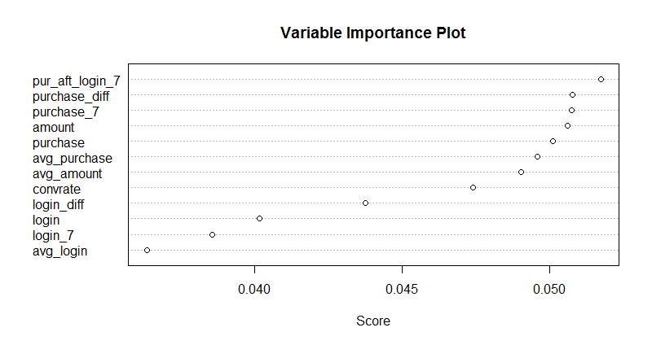
Boosting Analysis
Top 4 variables as per Adaboost Algorithm:
1. pur_aft_login_7: ratio of purchase after login
2. purchase_diff: number of days since last purchase
3. purchase_7: average purchase in previous 7 day
4. amount: purchase amount
Model:
label ~ login + purchase + amount + login_7 + purchase_7 + pur_aft_login_7 +
login_diff + purchase_diff + avg_login + avg_purchase + avg_amount +
convrate

Slide 12
Random Forest
Accuracy Achieved: 0.9807022
Concept:
It combines the predictions made by multiple decision trees, where each tree is generated based on the values of an independent set of random vectors. The random vectors are generated from a fixed probability distribution.
Pros:
It produces a highly accurate classifier.
It runs efficiently on large databases.
It can handle thousands of input variables without variable deletion.
It gives estimates of what variables are important in the classification.
Cons:
Random forests sometimes overfit for some datasets with noisy classification/regression tasks.
Unlike decision trees, the classifications made by random forests are difficult for humans to interpret.

Slide 13
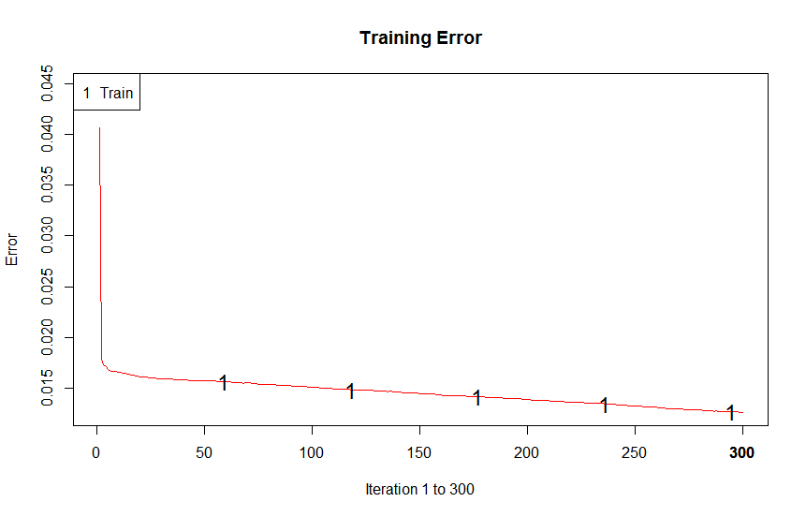
Random Forest Analysis
Model:
label ~ login + purchase + amount + login_7 + purchase_7 + pur_aft_login_7 + login_diff + purchase_diff + avg_login + avg_purchase + avg_amount + convrate

Slide 14
Results
 | AdaBoost | Random Forest
Accuracy | 0.9806116 | 0.9807022
Senisitivity/True Posistive Rate | 0.9944811 | 0.994653039
Specificty/True Negative Rate | 0.6101342 | 0.608052824
Precision | 0.985536 | 0.985462338
Recall | 0.99448108 | 0.994653039
F1 Measure | 0.98998833 | 0.990036359
50% data was used for Training and Testing AdaBoost and Random Forest
Random Forest and AdaBoost and have roughly same statistics
Their accuracy is slightly than SVM and Logistic Regression Model.
Over all our models are good fits to the data

Slide 15
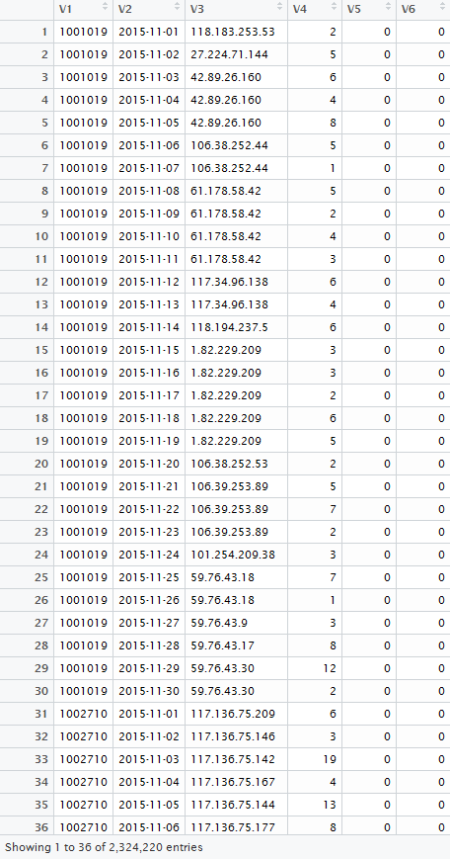
Data Explanation
The data is retrieved from a Chinese online-shopping mobile app.
We have 2324220 rows of observations and 6 variables. There are 77474 different users who have at least login onto the app once in November 2015.
Column 1 is user id, which is unique for each user. Column 2 is date, which range from 2015-11-01 to 2015-11-30. Column 3 is the most frequently used IP address by specific user on that day. Column 4,5,6 indicates the total login times, purchase times, and total money spent for user on each day accordingly. There are 77474 different users who have at least login onto the app once in November 2015.

Slide 16
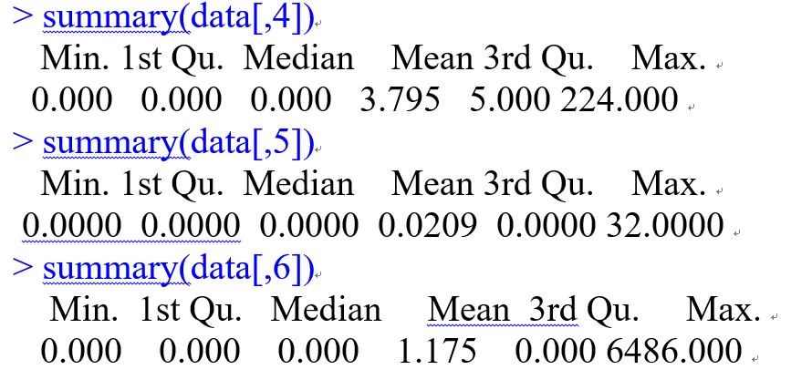
If we sum up the one month activities for each user, we can get the statistics of total login times, purchase times, total purchase amount:
The statistics suggests that average number of user login is 114 times per month, 4 times per day. The average spending is 35.25 CNY per month, 1.175 CNY per day. All three vectors have median much lower than mean, which suggest highly right-skewed distribution. For purchase times and purchase amount, since the 3rd quantile is zero for both vectors, it suggests that most of the users are window-shopping, and only a few users purchased a lot.

Slide 17
The maximum amount of login times for any user in any day is 224 times, the average amount of login times for any user in any day is 3.795 times. The maximum amount of purchase times for any user in any day is 32 times, and the maximum amount of total purchase amount in one day for any user in any day is 6486 CNY. The distribution of fifth and sixth column is highly right-skewed, That is why the median and 1st & 3rd quantile value is zero for purchase times, and total money spent for each user on each day.

Slide 18
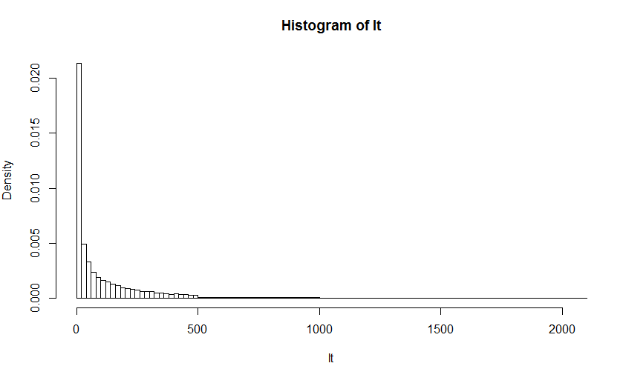
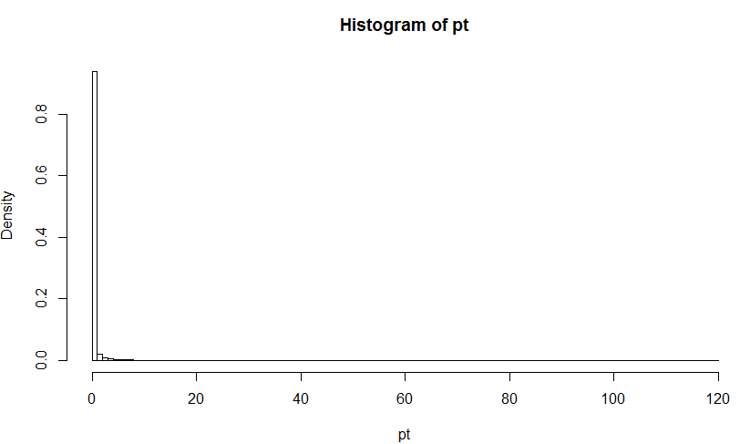
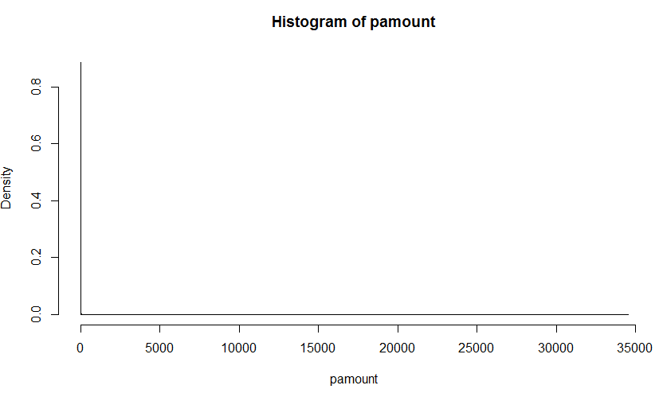
The distribution of total login times, purchase times, and total purchase amount in November 2015 for different users:

Slide 19
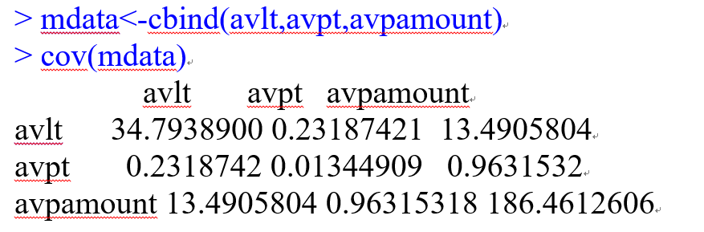
avlt: average login times per user per day.
avpt: average purchase times per user per day.
avpamount: average total purchase amount per user per day.

Slide 20
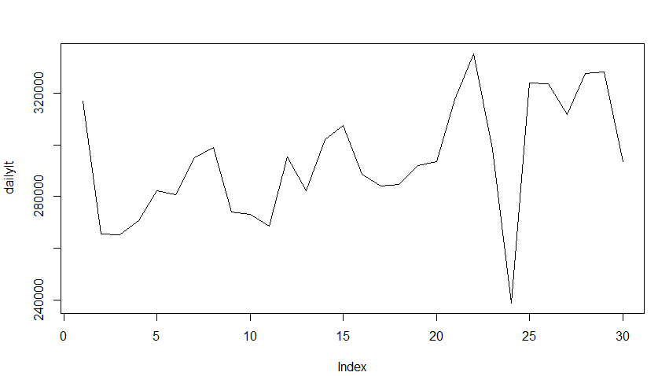
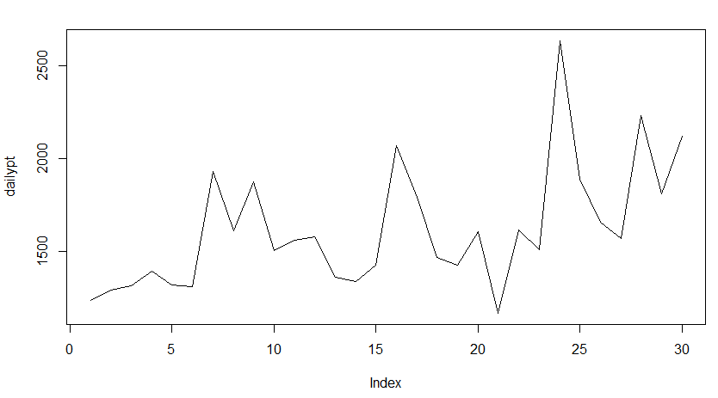
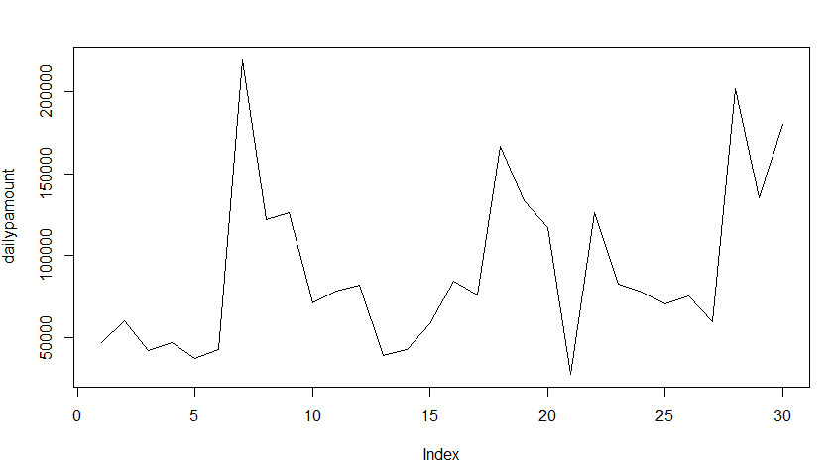
If we sum up all activities of users for each day, we can get three crude time series for total login times, purchase times, and total purchase amount.
Daily total login times:
Daily total purchase times:
Daily total purchase amount:

Slide 21
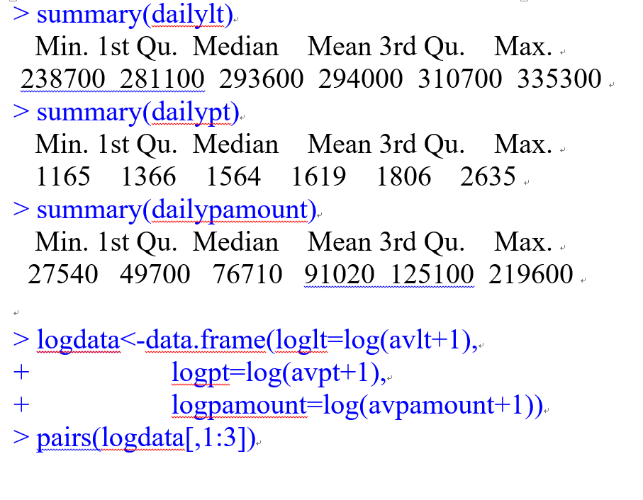
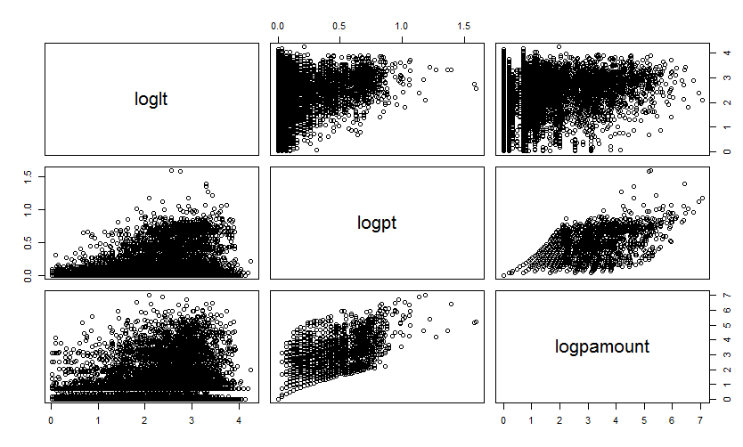
After log transformation, we can see there is a vague linear relationship between logpt and logpamount. A possible explanation might be most users spent 6 CNY in one purchase times.

Slide 22
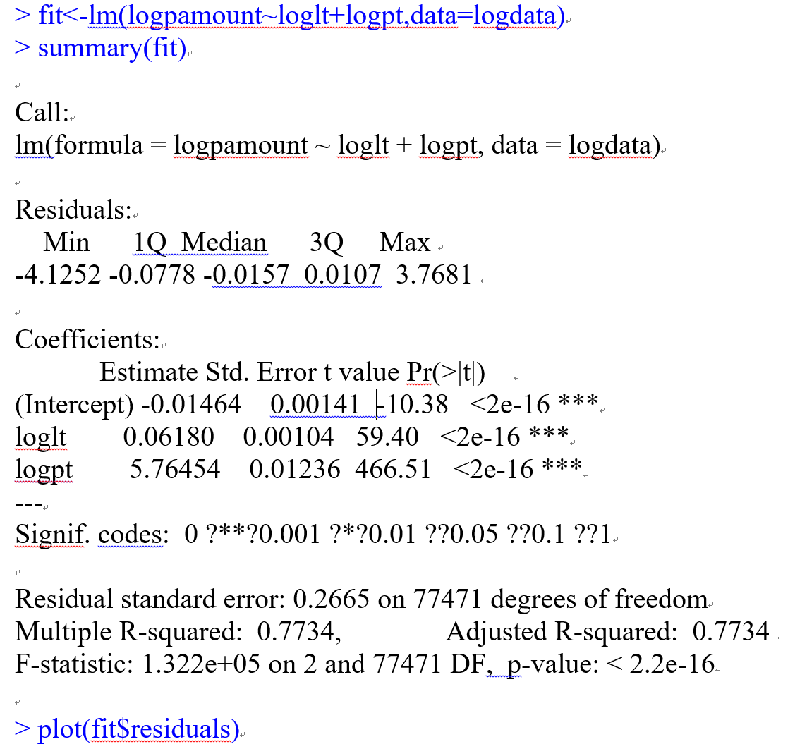
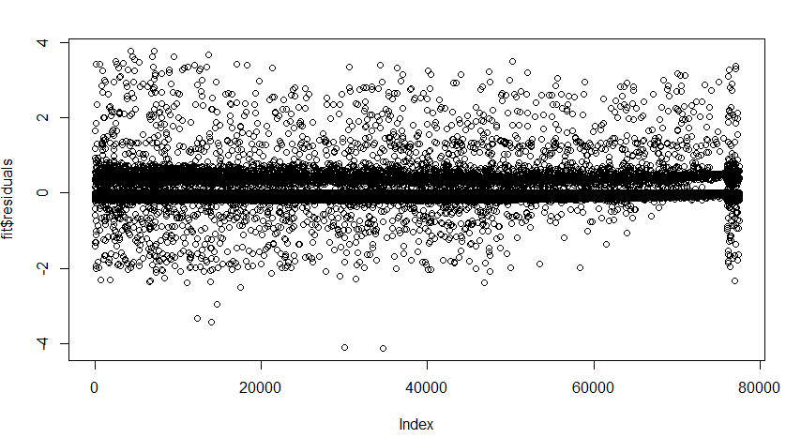
We tried to do a multiple linear regression to find the relationship between logpamount with loglt and logpt. The coefficients are significant and R-square is relatively high. However, the residue plot shows strong correlation between residues, so simple multiple regression will not work.

Slide 23
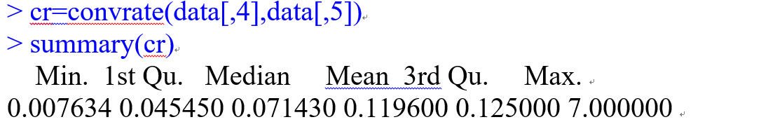
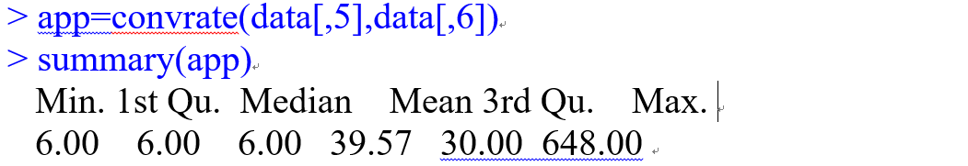
Conversion rate, which is number of purchase/number of login:
Purchase amount per purchase, which is total amount of purchase/number of purchase:
The median and 1st quantile equal to 6 means that more than half of purchase amount is 6 CNY per purchase, distribution of app is right-skewed.

